Slide 1
Welcome
Guidance steps for how Smart Travel works
Project by : Group no. 9
Samiksha Dhere
Aditya Ladawa
Yash Wadekar
Tushar Pawar
Sayee Aher

Slide 2
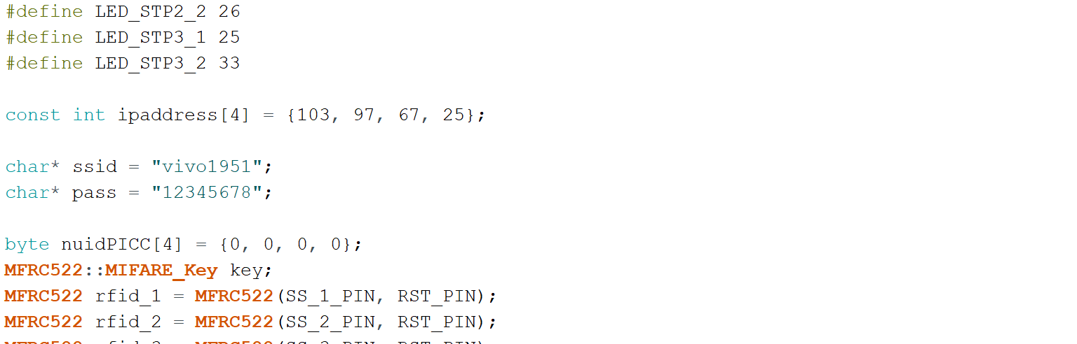
Steps for Hardware Connection
Step 1 : Open Arduino IDE and copy the code.
Step 2 : Connect your device having Arduino ide with ESP 32 via USB cable.
Step 3 : Connect the device with any wifi.
Step 4 : Copy wifi id and password and edit it on code on line 21 and 22 respectively.
Change id and password according
to the wifi device. (Line 21 and 22)

Slide 3
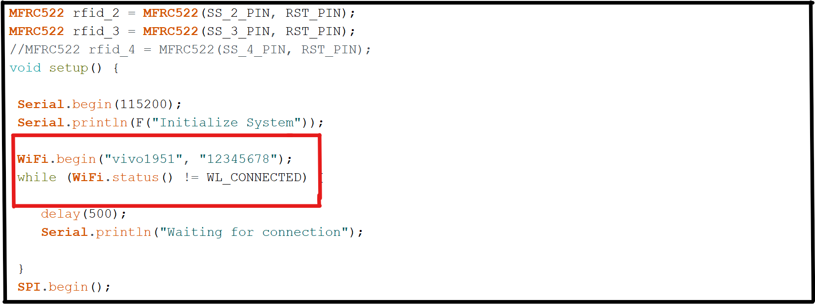
Step 5 : Copy and paste the same wifi id and password on line 35.
Change wifi id and
password on line 35

Slide 4
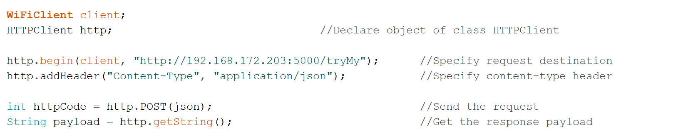
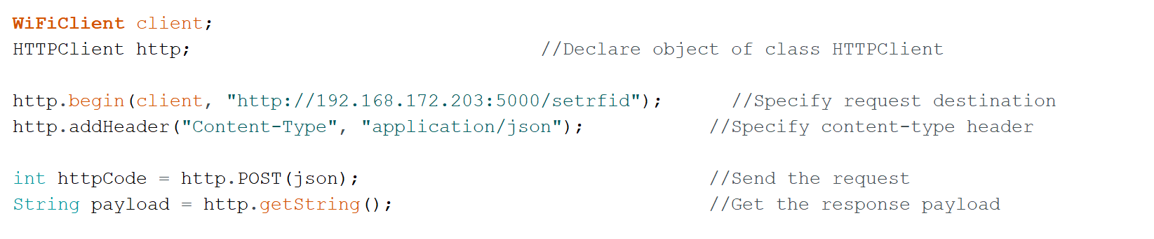
Step 6 : Copy the ip address of the wifi device.
Step 7 : Paste the same ip address on line 267 and 301. (Go to backend connection for IP address from step 1 to step 5) .
Change ip address at line 267
Change ip address at line 301

Slide 5
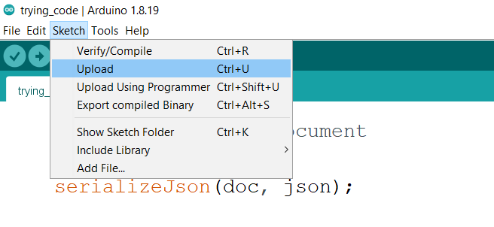
Step 8 : Go to sketch and upload the code.

Slide 6
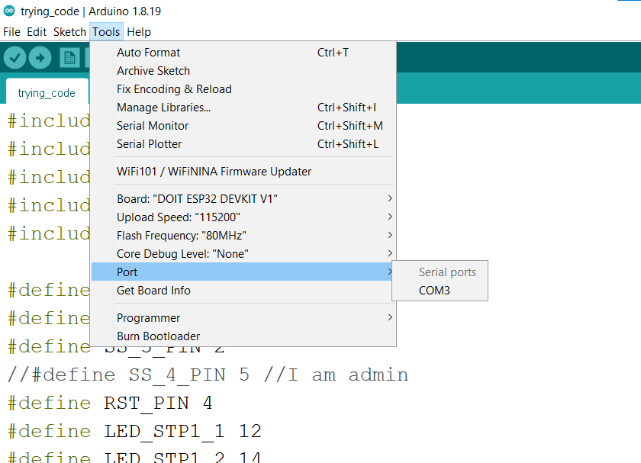
Step 9 : Go to tools > port and select com 3.

Slide 7
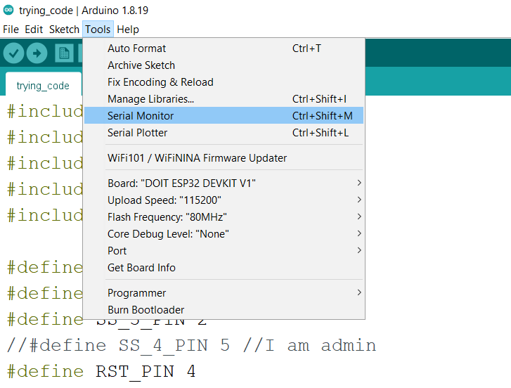
Step 10 : Go to tools and select serial monitor and wait for connection.

Slide 8
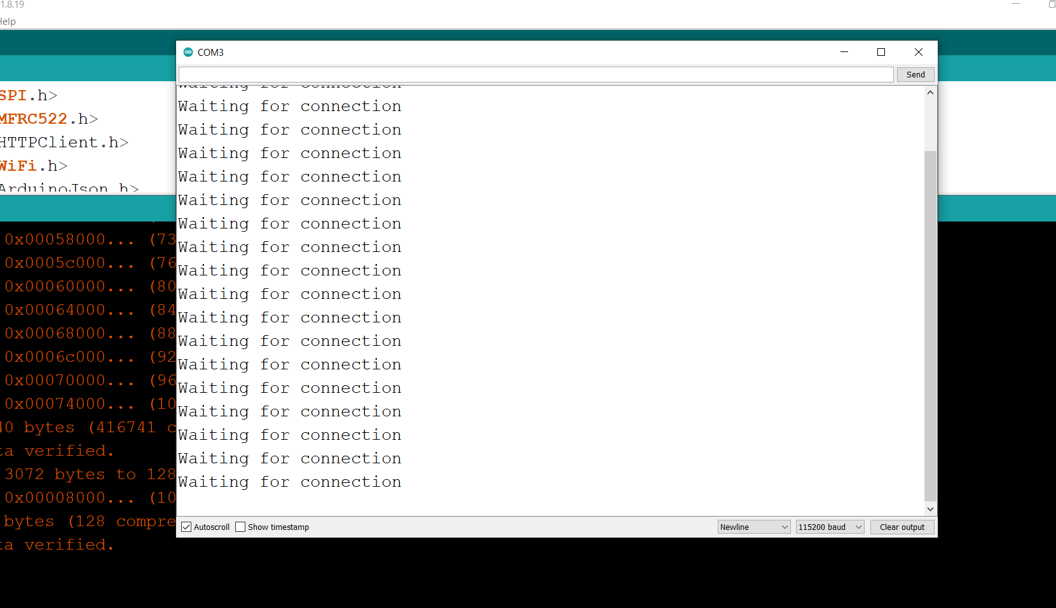
RFID is ready to work now, Go to backend. (From step 6)

Slide 9
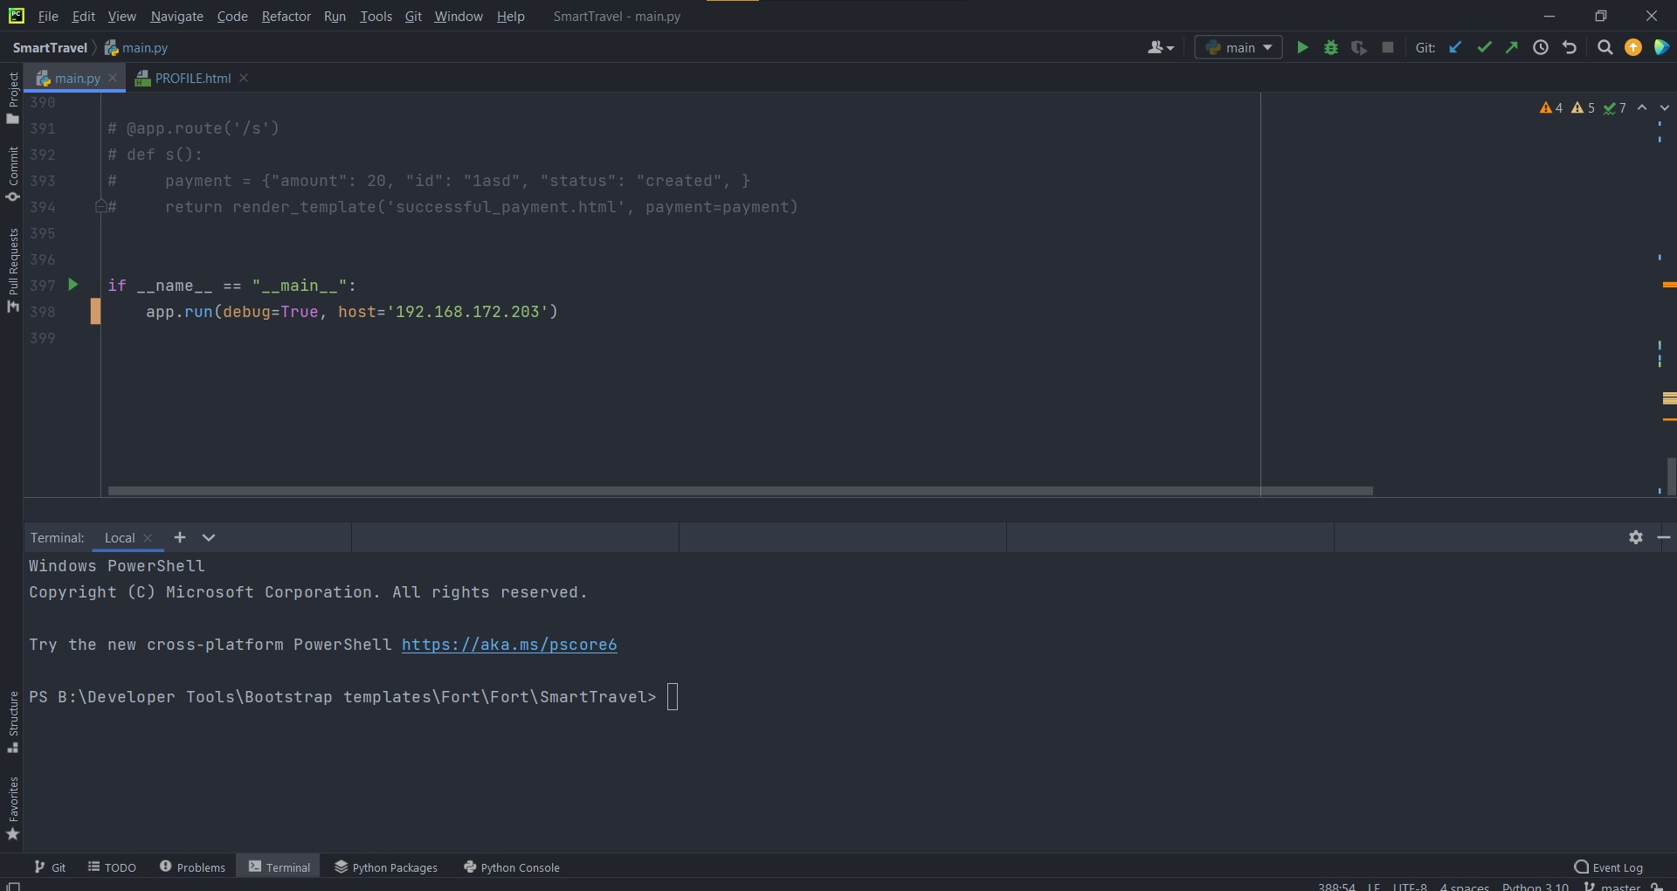
Steps for backend connection
Step 1 : Open project folder in pycharm.

Slide 10
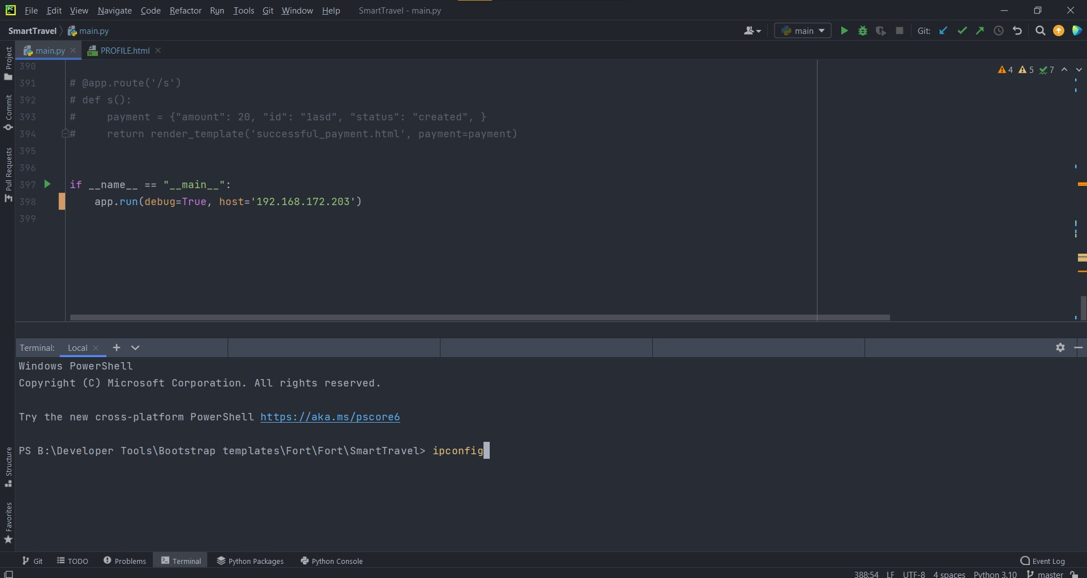
Step 2 : Go to terminal and type command “ipconfig” and press Enter key.
Step 3 : Scroll till end in terminal and copy the “IPV4” ip address of the wifi your device (your laptop) is connected to.

Slide 11
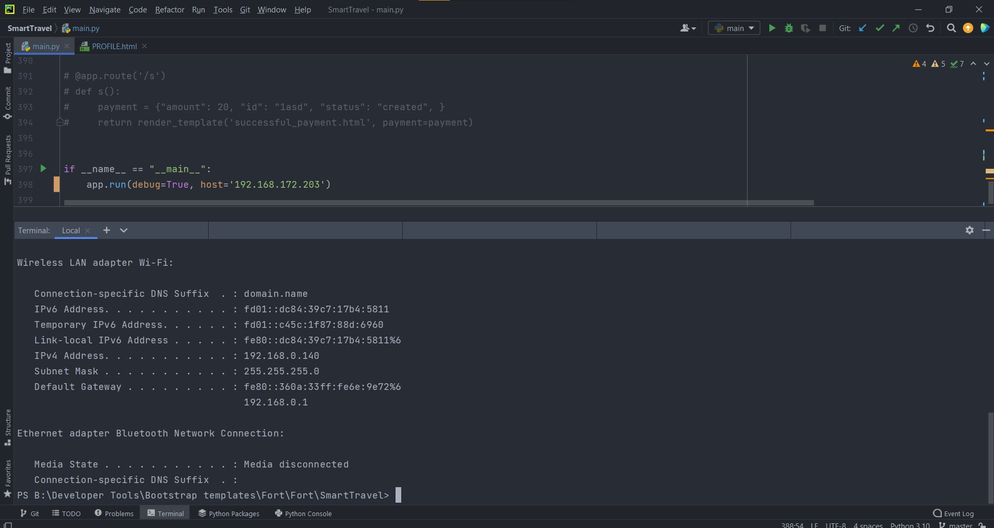
Step 4 : Paste the address in the last most line of your code namely-
if __name__ = “__main__”:
app.run(debug=True, host=‘IPV4 copied’)
And then press the “Run” button on top right corner in green color. (represented by green box)

Slide 12
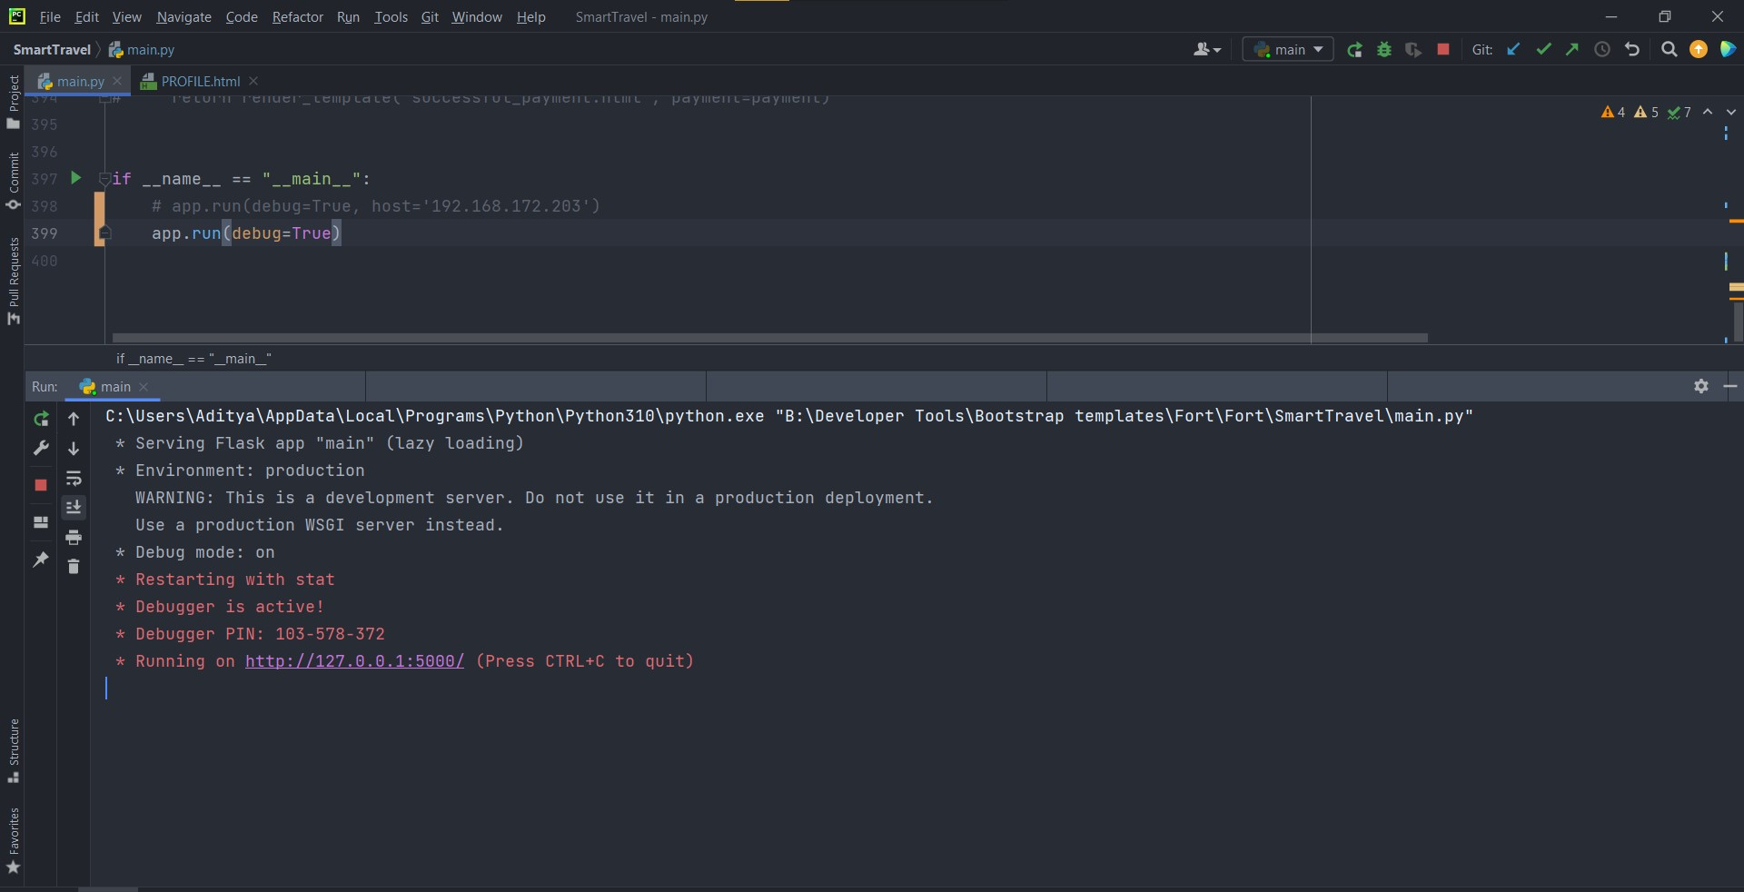
Step 5 : Then from terminal, copy the URL highlighted in pink box and paste it in your browser.

Slide 13
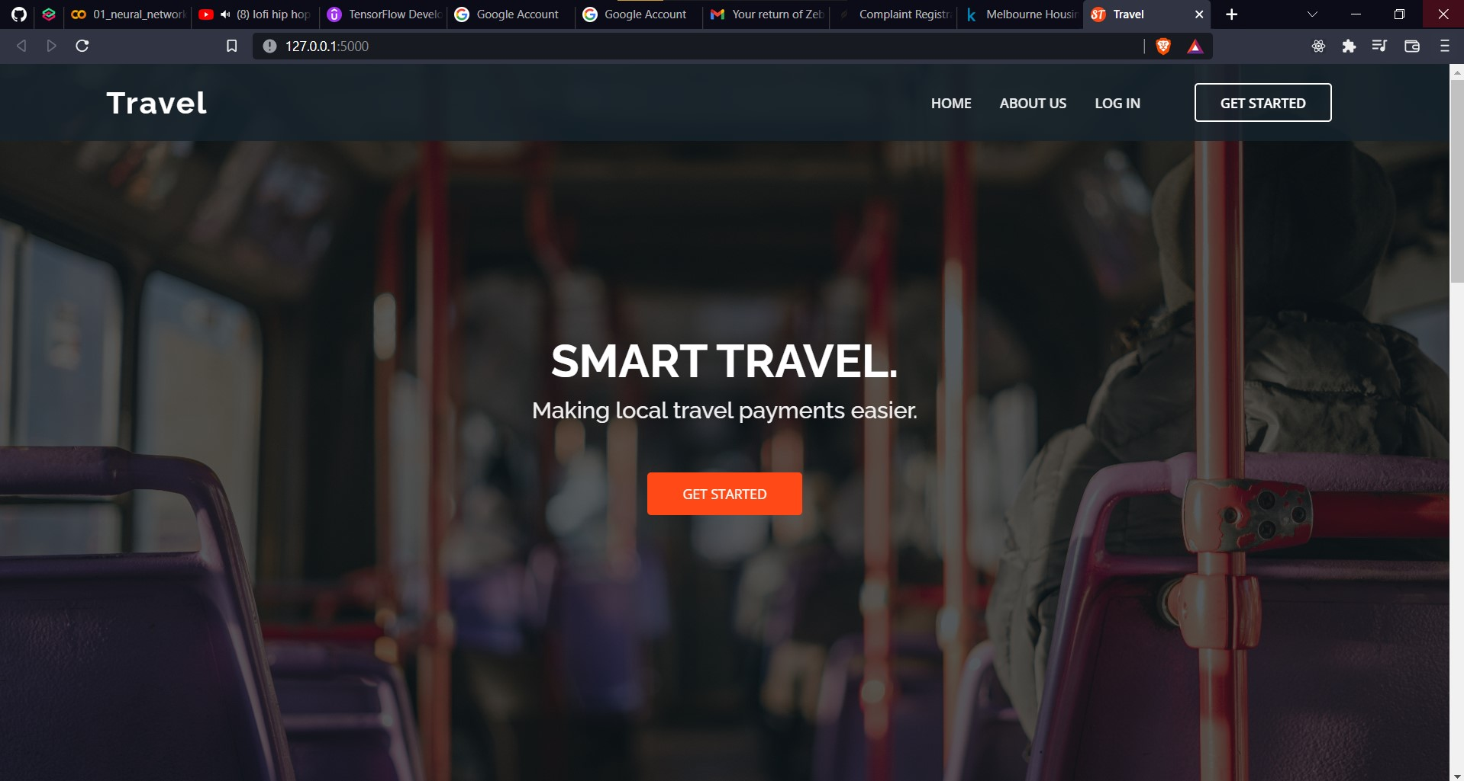
Step 6 : After entering on website click on login button to log in or “Get started” button to create new account.

Slide 14
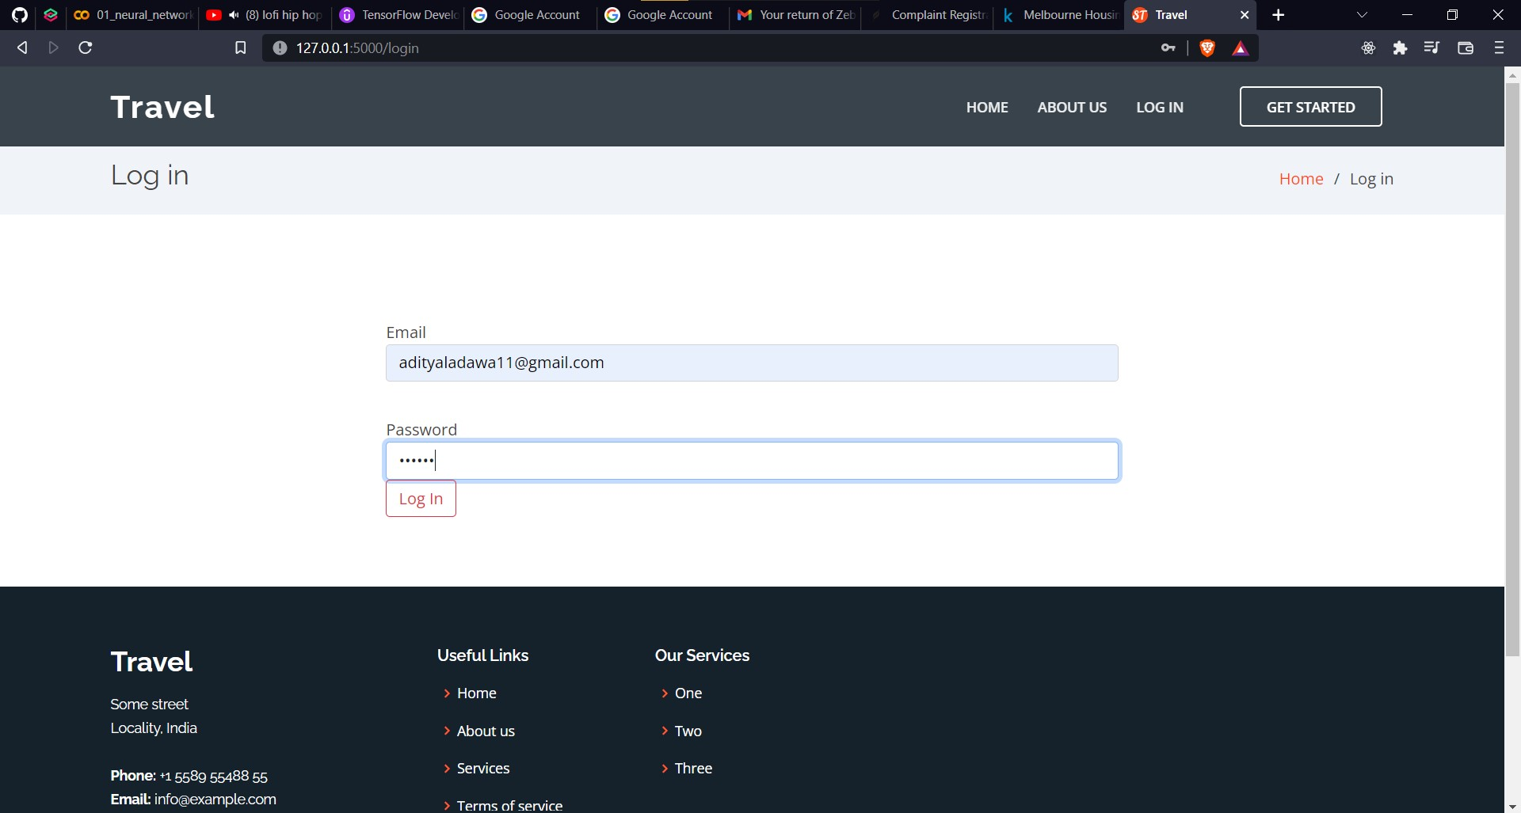
Step 7 : Enter the email as – adityaladawa11@gmail.com
password = 123456
NOTE : This is admin email and password with this you get access to admin privileges which allows you to add RFID card number to a new user or delete any user except “admin” user itself.

Slide 15
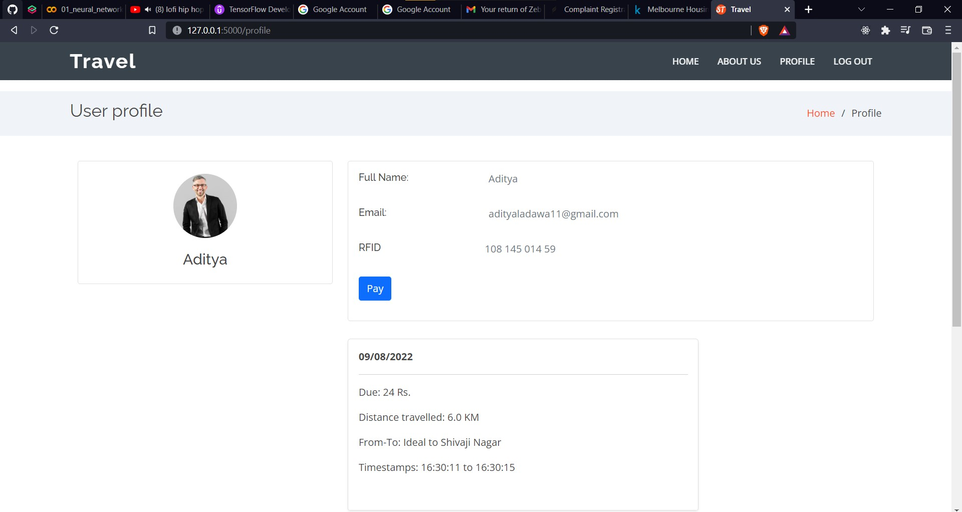
Step 8 : After logging in you can visit your own profile page to see your personal info and recent ticket payment transactions history or to pay pending ticket dues.

Slide 16
Since the email adityaladawa11@gmail.com has admin privileges you may type in “/admin” in URL box as –
http://127.0.0.1:5000/admin
NOTE : No other email id has this privilege and causes 404 restriction error.

Slide 17
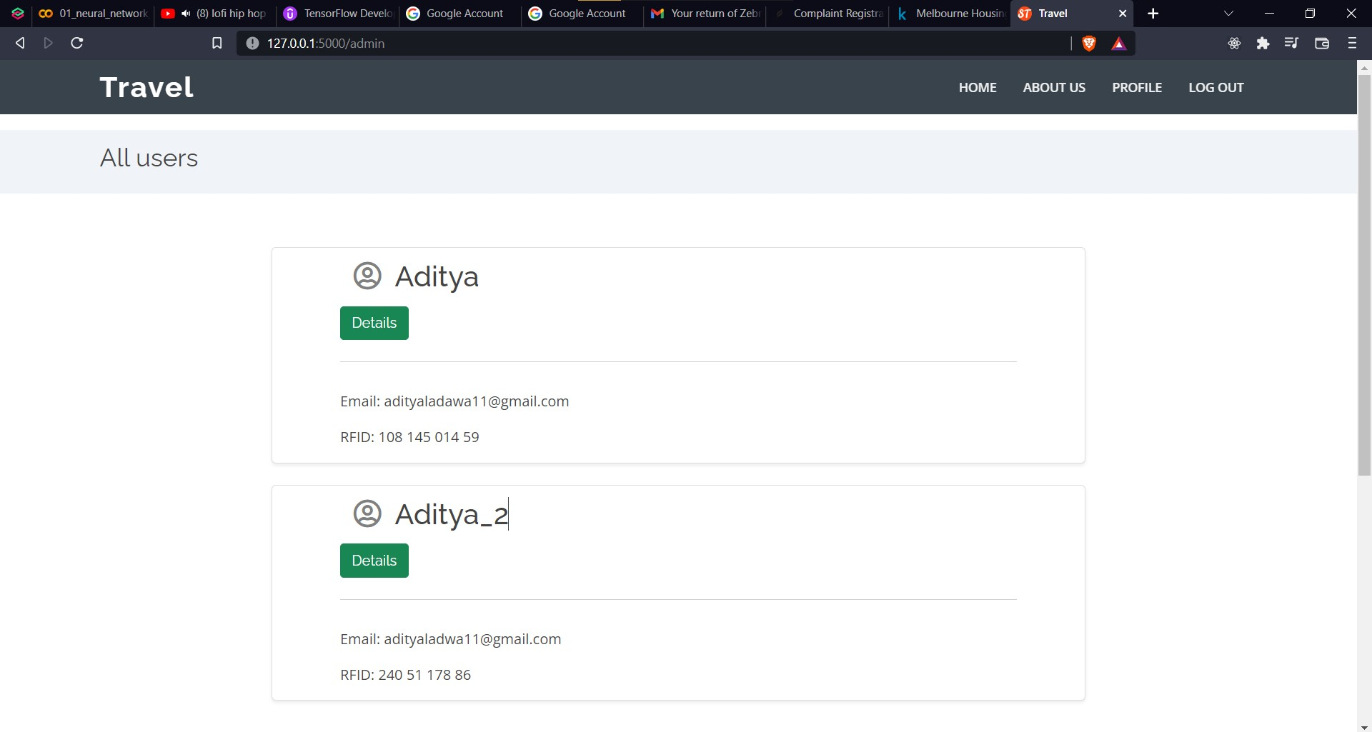
Note :
You can see all the active users and their personal details as admin.
From here you can scan RFID for users who dose not have an active account by clicking on “Details” button and filling the RFID number in the given textbox.
You can also click “Details” button to get more details

Slide 18
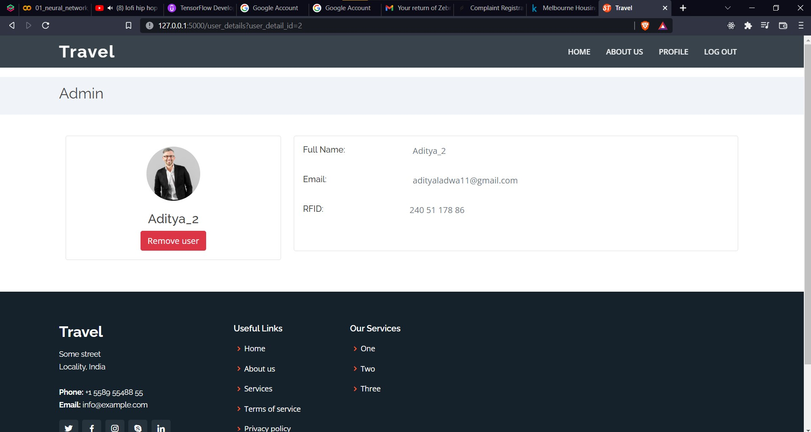
Note :
You can delete an user too by clicking on “Remove user” button. This will remove user from database itself.

Slide 19
Thankyou

